Slide 1
Ansible Automate One Thing
Peter Maranian – Sr. Solutions Engineer
Irfan Khan – F5 Solutions Engineer

Slide 2




Our Team
Peter Maranian
Sr. Solutions Engineer p.maranian@f5.com
Irfan Khan
Solutions Engineer i.khan@f5.com
Bob Hanson
Solutions Engineer bo.hanson@f5.com
Andy Conley
Solutions Engineer a.conley@f5.com

Slide 3
Logging in to the course
You would have received an email instructing you to create an account on F5 Unified Demo Framework
As per the email you received yesterday – you need an account to log into the F5 Unified Demo Framework (including 2FA)
Did you create an account prior to today’s course?
If so – Great work!!!!
If not – Please follow the instructions in that email now

Slide 4
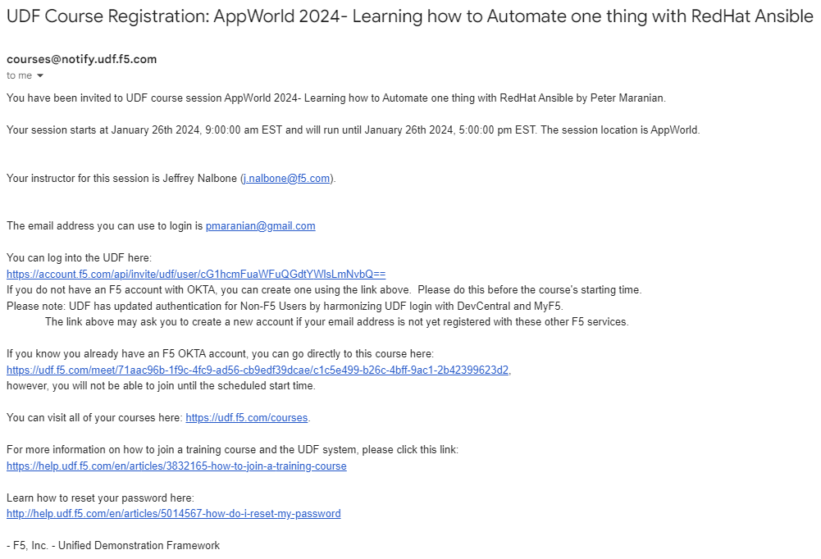
Logging in to the course
Click on this link to log in and join the course

Slide 5
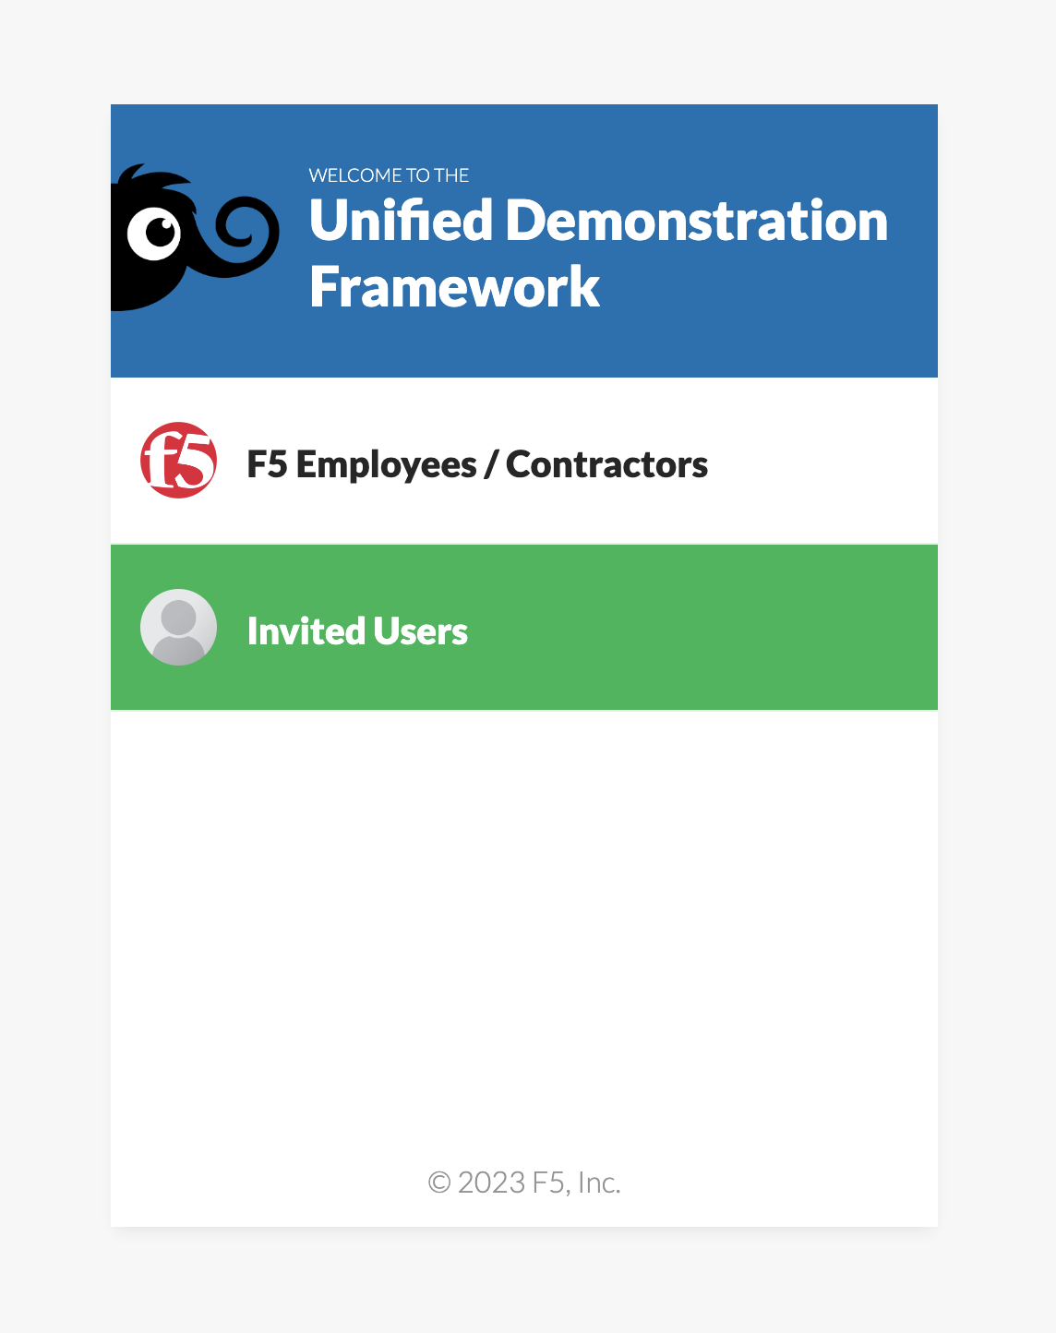
Logging in to the course
Click “Invited Users”

Slide 6
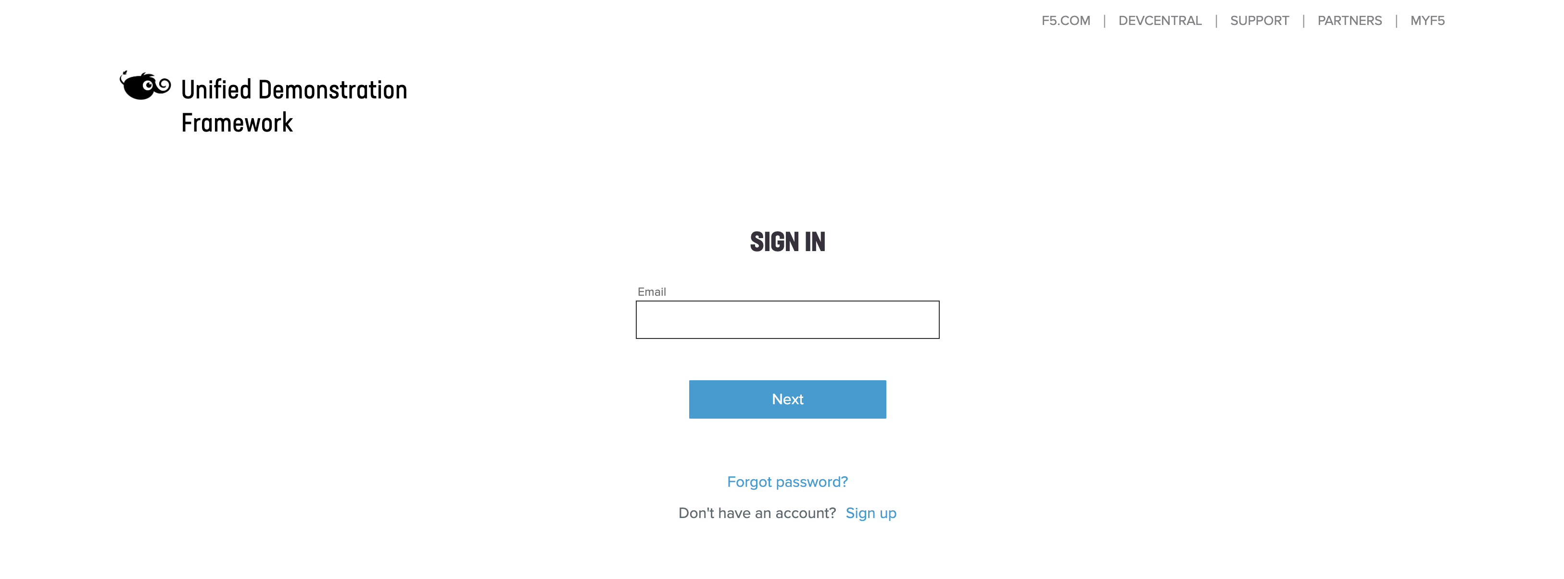
Logging in to the course
Log in with the credentials you set up yesterday

Slide 7

Logging in to the course
Verify with 2FA you set up when you created your account

Slide 8
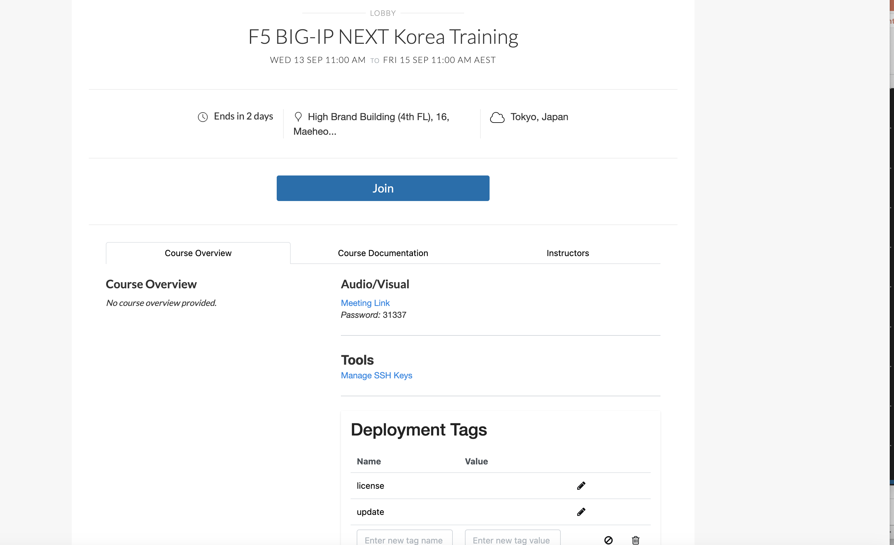
Logging in to the course
Join the session
Click on this link to log in and join the session

Slide 9
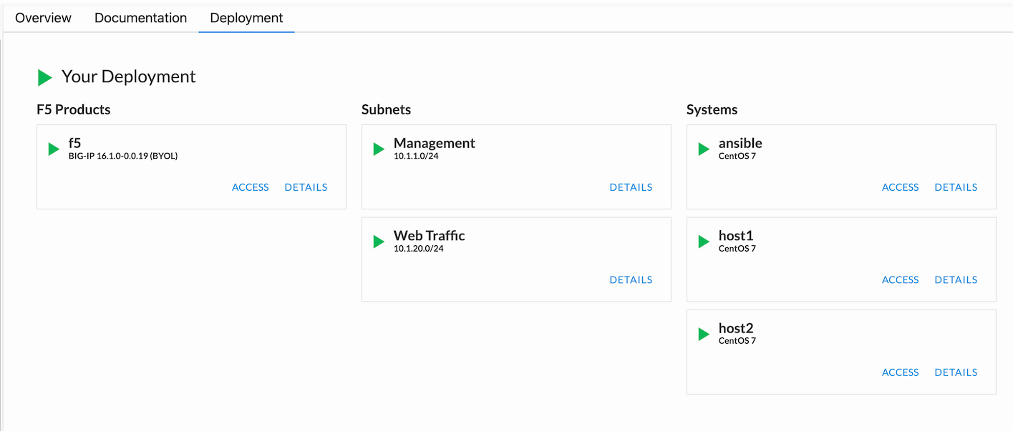
Logging in to the course
Verify your deployments are starting

Slide 10

Agenda
Ansible Presentation
Ansible Automate One thing Lab
Ansible Q & A

Slide 11
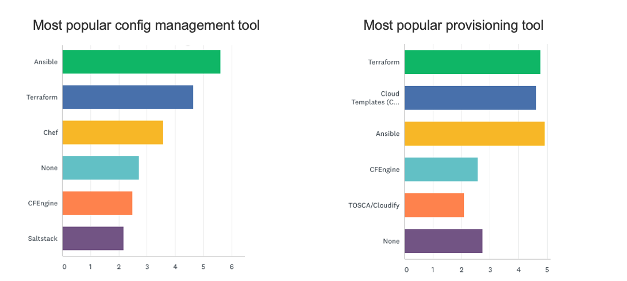
Why we are here

Slide 12
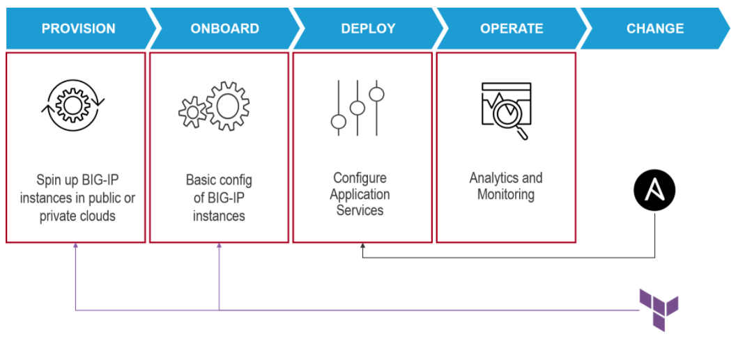
Lifecycle of BIGIP Device

Slide 13
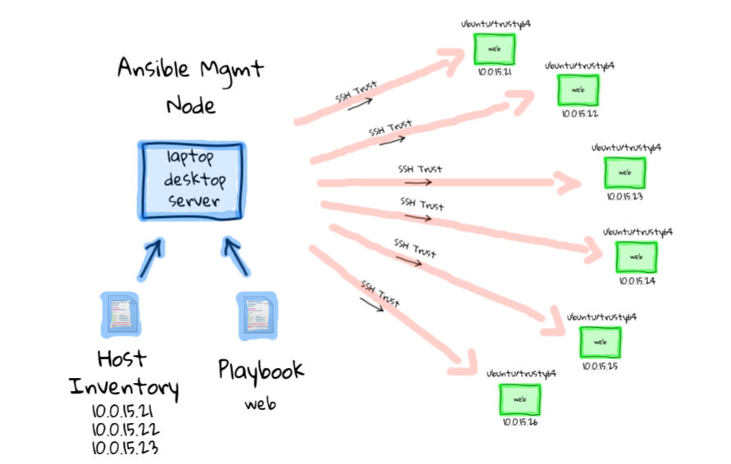
Ansible - Components

Slide 14
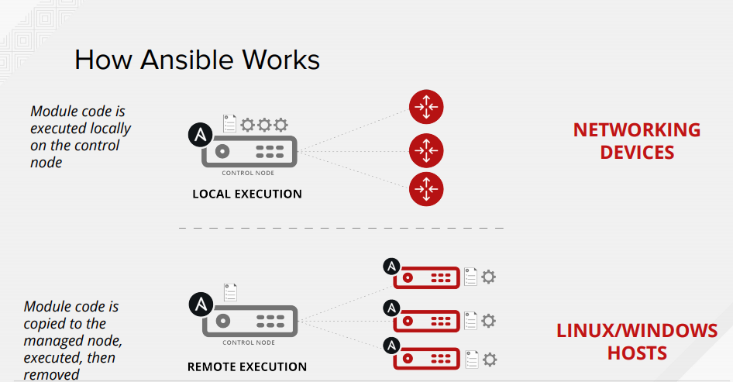
How Ansible Works

Slide 15
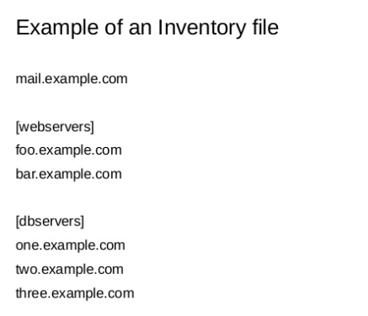
Inventory File

Slide 16
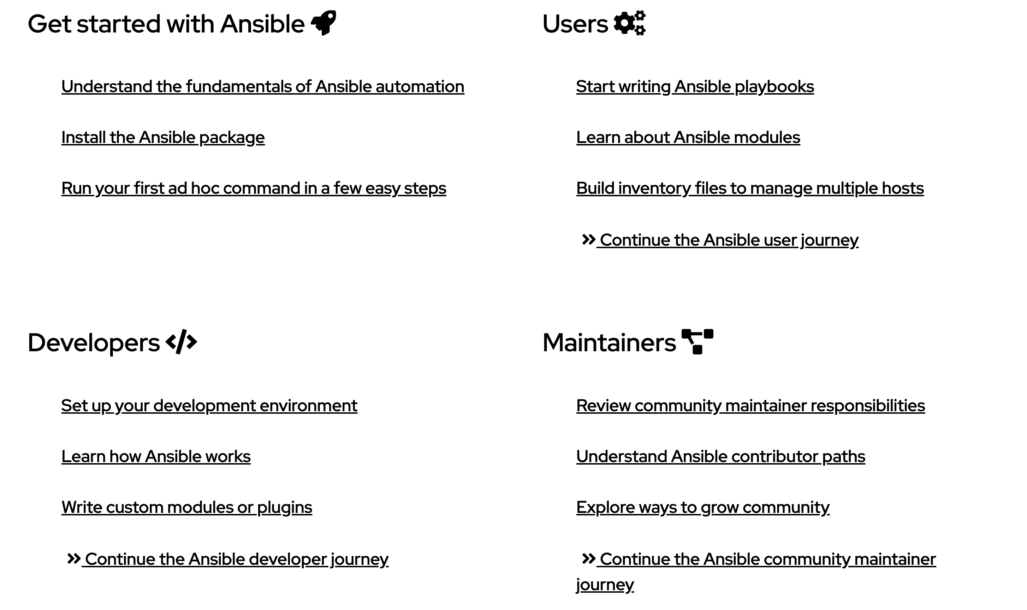
Ansible Docs – docs.ansible.com

Slide 17
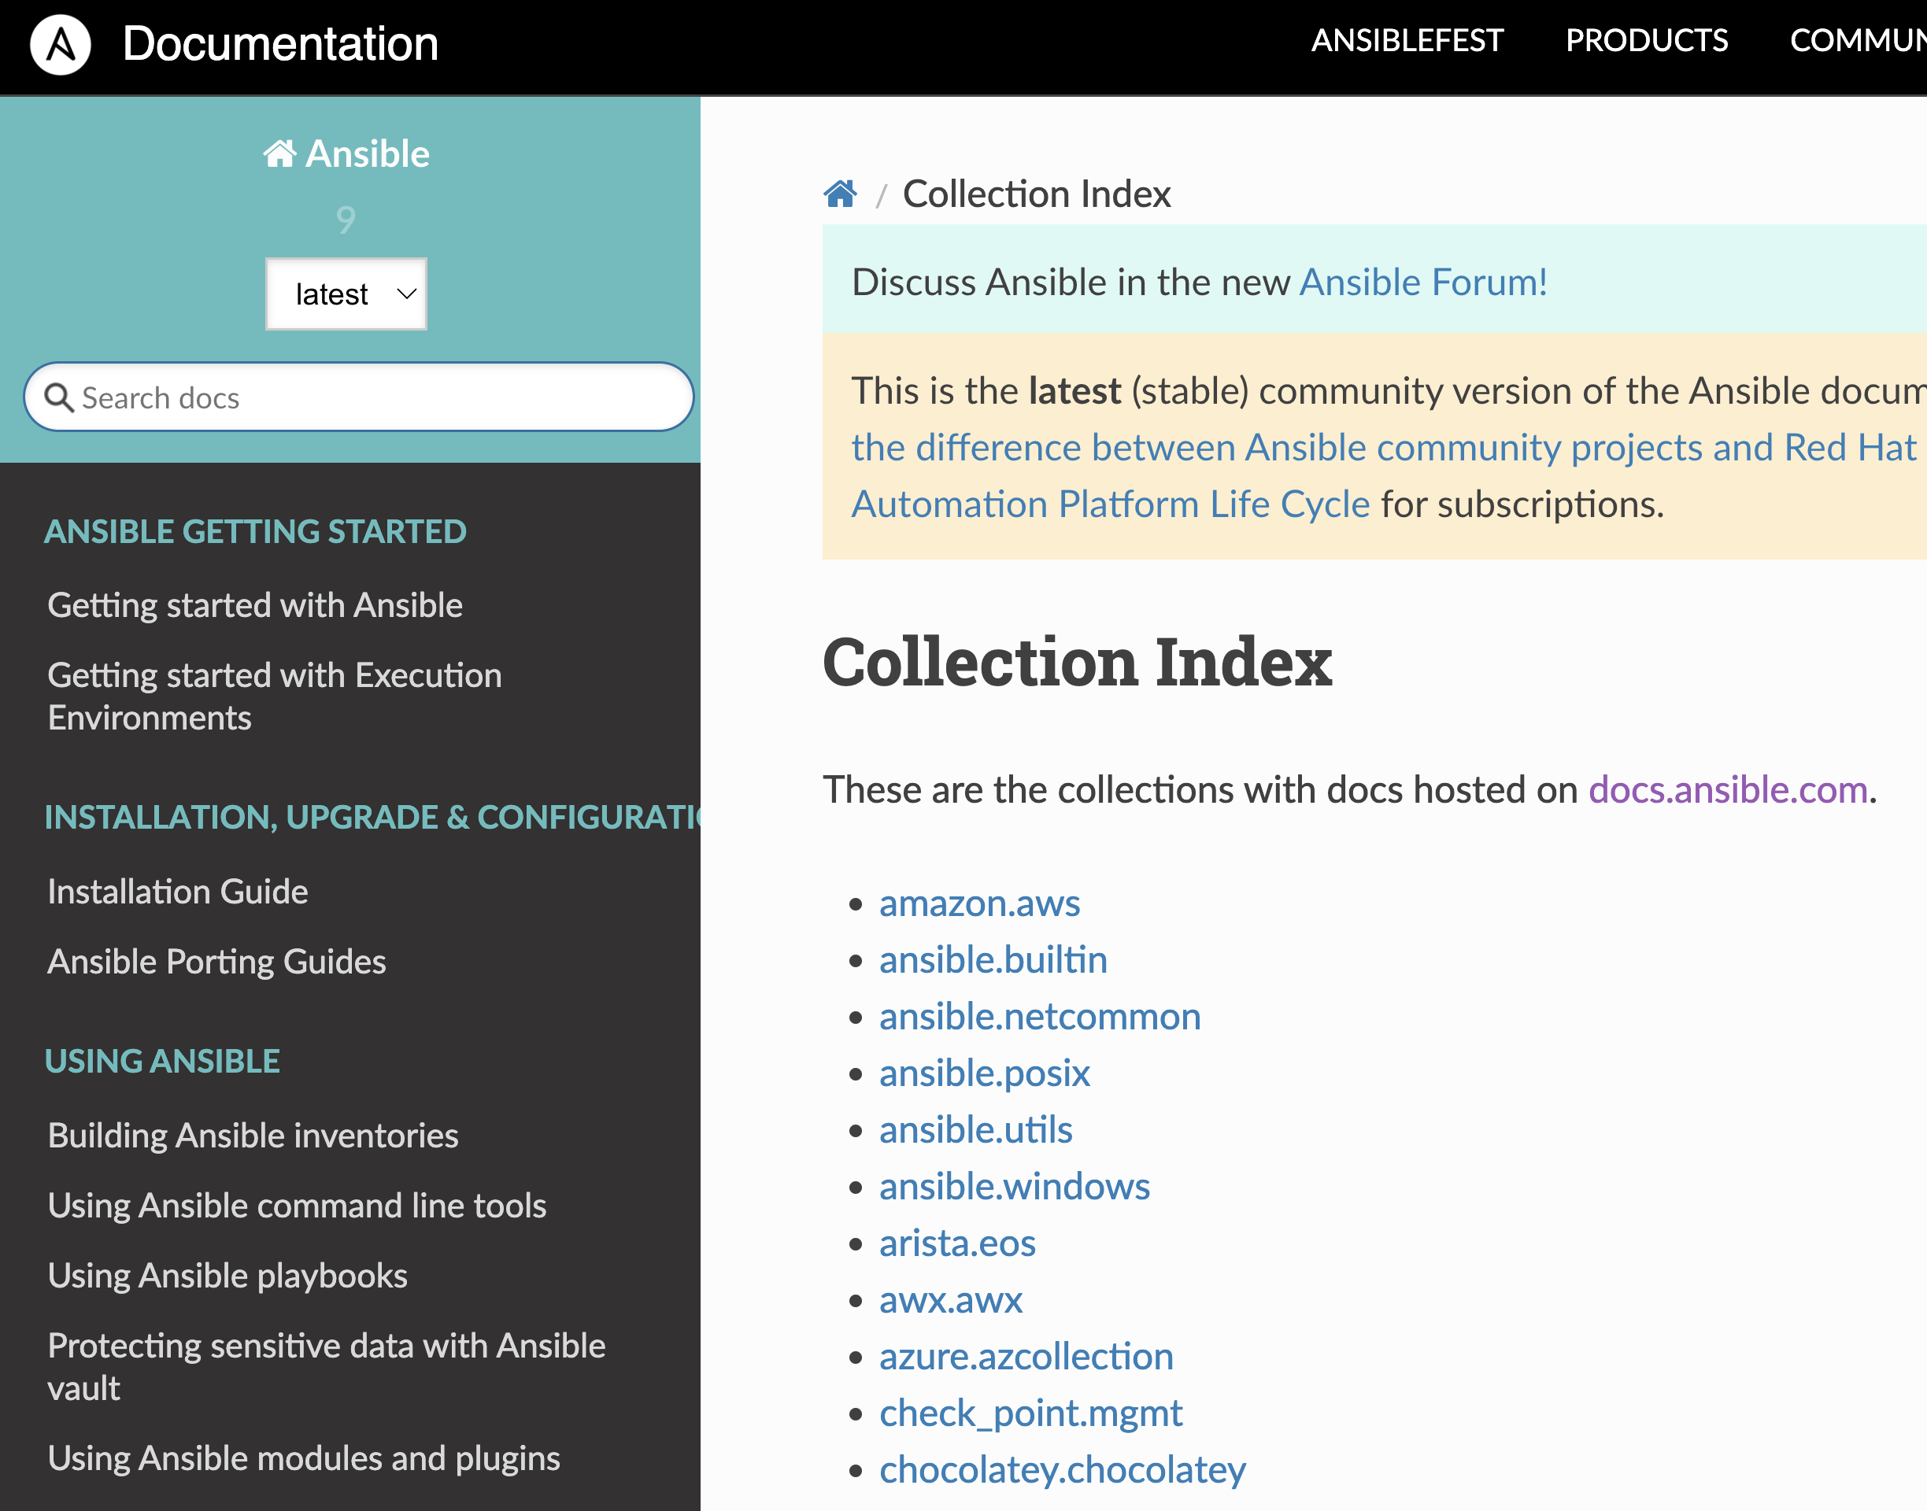
Understanding Module
To perform tasks such as installing a package, restarting a service, or copying a configuration file.
Documentation for each module is available on ansible.com or ansible-doc command

Slide 18
F5 vs Competitors
A10 - 4 modules
Avi - 60+ modules
Citrix - 15 modules
Radware - 3 modules
F5 170+ modules

Slide 19
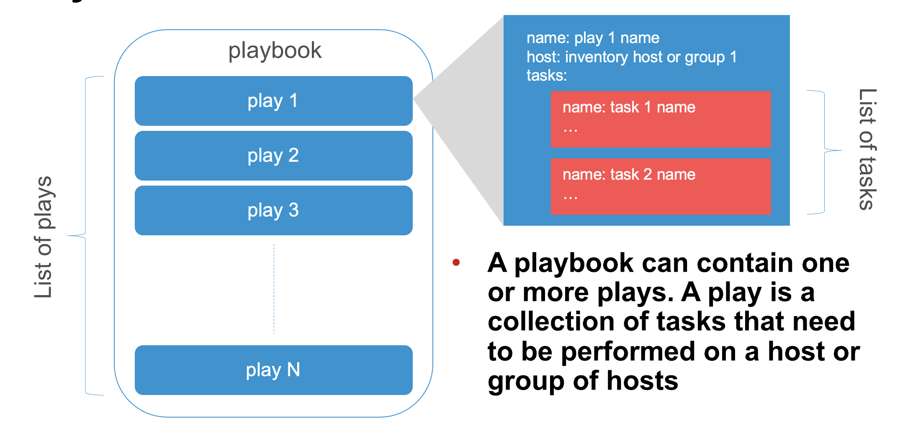
Playbook

Slide 20
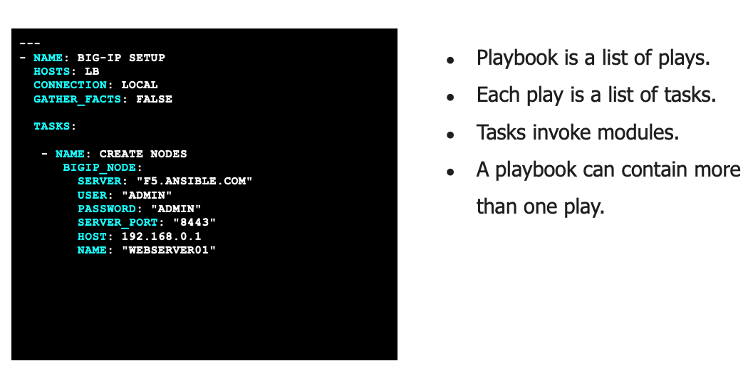
Sample F5 Ansible Playbook

Slide 21
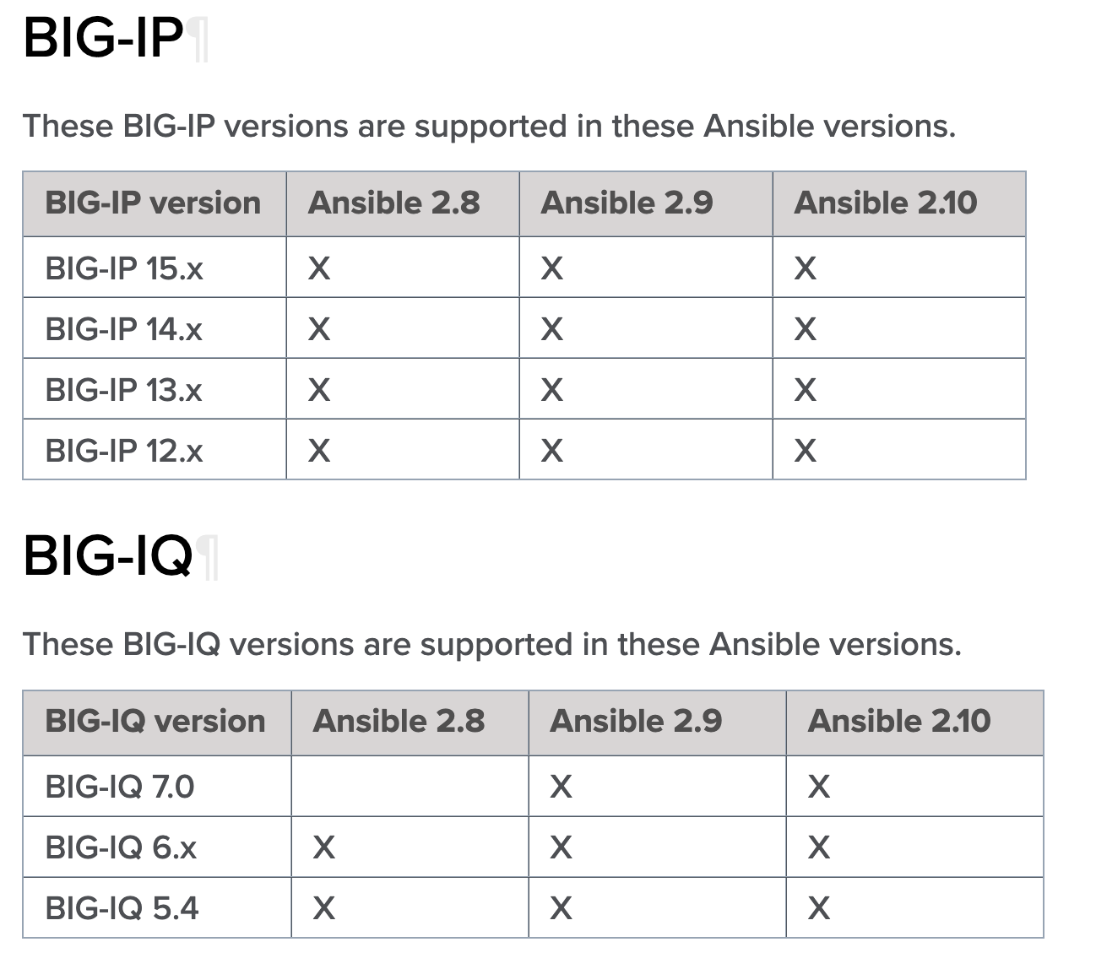
Releases and Versioning

Slide 22
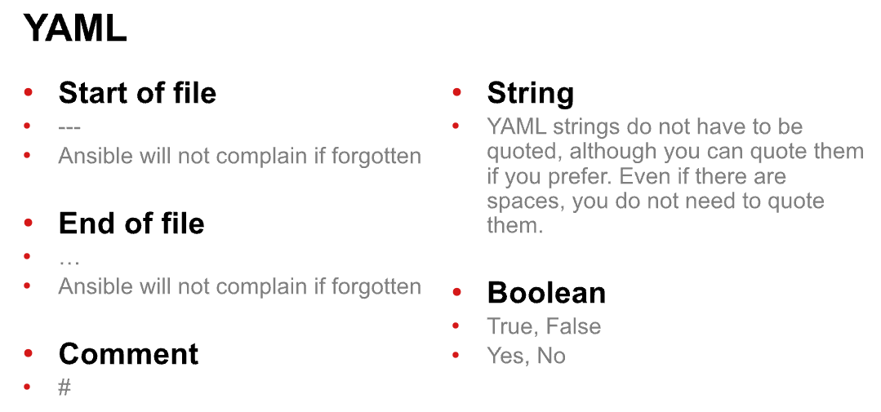
YAML format

Slide 23
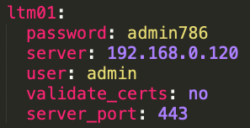
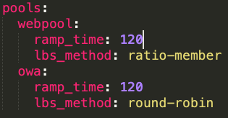
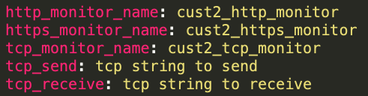
Variable - YAML format
Lists or Sequences
Dictionaries or Mappings Variables
http://www.yamllint.com/
YAML Syntax Checker

Slide 24
Understanding imperative vs. declarative
Real world Example: eating a sandwich
Imperative model: What everyone’s done for years. Every step of a process is meticulously defined, resulting in the desired outcome.
Declarative model: The model that F5 has aligned to. Just input the desired end-state and let the system figure out the rest.
Declaration
System Processes
End-state
A sandwich would be good
Find a recipe for PB&J
Ensure you have ingredients
Buy the required ingredients
Assemble the sandwich
Spread jelly on bread
Spread peanut butter on bread
Cut two slices of bread from loaf
Order a #3 with cheese
Meal gets made by the “system”
Enjoy the #3 with cheese!
Slice the sandwich
Put the sandwich on a plate
Enjoy the carefully crafted sandwich

Slide 25
Declarative Benefits
Benefits
Minimizes need for F5 expertise
Speeds dev time
Requires few API calls
Minimizes deployment errors
Eases integration into A&O systems
Repeatable and enforces policy compliance
DECLARATIVE
Tell the system WHAT you want, and let it figure out HOW to do it
Declarative API – Abstracts config complexity with single API call

Slide 26
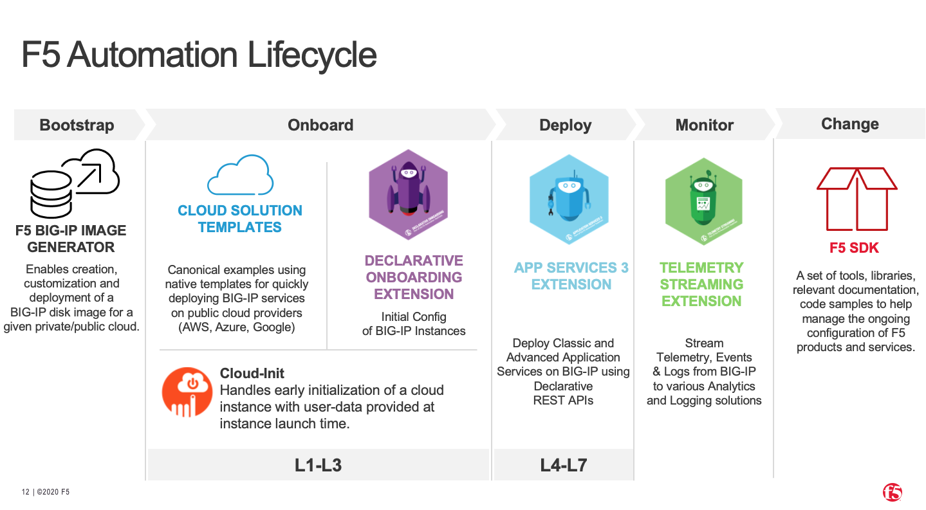

Slide 27



Automation for BIG-IP NEXT
Application Services Ext. 3 (AS3)
Application Templating (FAST)
AS3 will be the customer-facing API for BIG-IP NEXT (replacing iControl).
Touched on benefits of Declarative vs Imperative earlier.
Ability to reuse existing BIG-IP AS3 declarations on NEXT deployments is an added benefit.
No longer requires download/installation as it is fully integrated with BIG-IP Next Central Manager.
Templates to be consistent and reusable across BIG-IP and BIG-IP NEXT instances.
Telemetry Streaming
Device Onboarding
Telemetry streaming capabilities will be possible, however it will not be identical to TS offered with BIG-IP
Integrates with majority of 3rd party analytics / visualization software like Splunk, Grafana, etc.
NEXT CM will expose an API that tools like Terraform and Ansible can be used to call to complete device onboarding tasks.

